Slide 1
Bank of CLI
Justin Tywater

Slide 2
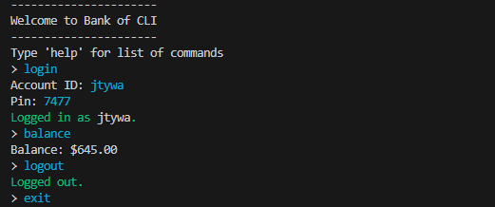
Introduction

Slide 3
Technology Stack
Java
Maven
PostgreSQL
JDBC
JUnit5
Git/GitHub

Slide 4
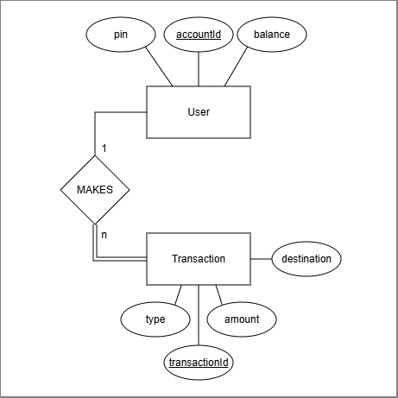
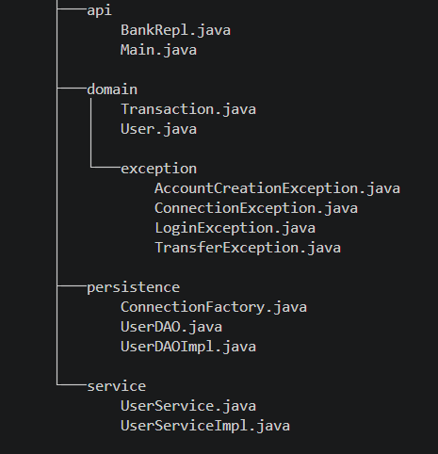
Architecture

Slide 5
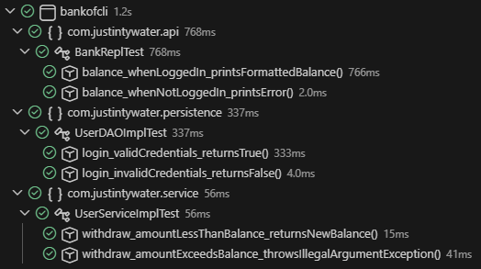
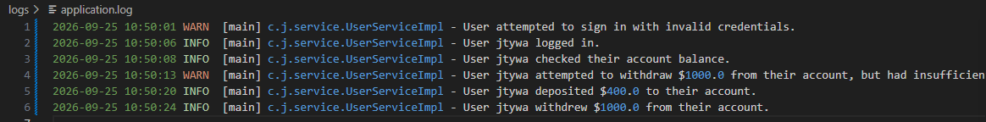
Testing and Logging
JUnit/Mockito
  Positive and Negative test cases for each layer
SLF4J/Logback
  Logging of all user events, system errors and warnings

Slide 6
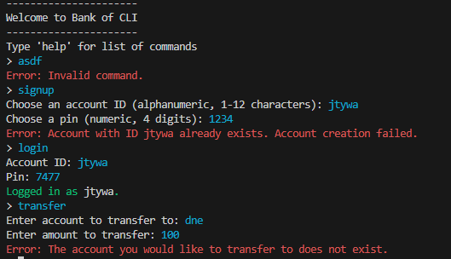
Validation and Error Handling
Layered input validation
Custom Exceptions to handle system errors
Helpful user messages

Slide 7
Applied OOP Concepts
Inheritance
  Custom Exceptions inherit from Exception; Concrete classes implement interfaces
Encapsulation
  Classes store data and related internal methods and expose a public interface
Abstraction
  Layers communicate through interfaces, hiding and decoupling concrete implementation
Polymorphism
  Concrete classes in each layer override their respective interface methods

Slide 8
Applied SOLID Principles
Single Responsibility
  Classes have a specific job and are not concerned with the implementation details of others
Open/Closed
  Classes are open to extension but closed to modification
Liskov Substitution
  Classes implement interfaces and are exchangeable; helpful for mock testing
Interface Segregation
  Layered interfaces provide only methods needed for that layer
Dependency Inversion
  Dependencies are passed to constructors rather than instantiated in the containing object

Slide 9
Live Demo

Slide 10
Q/A

